Slide 1

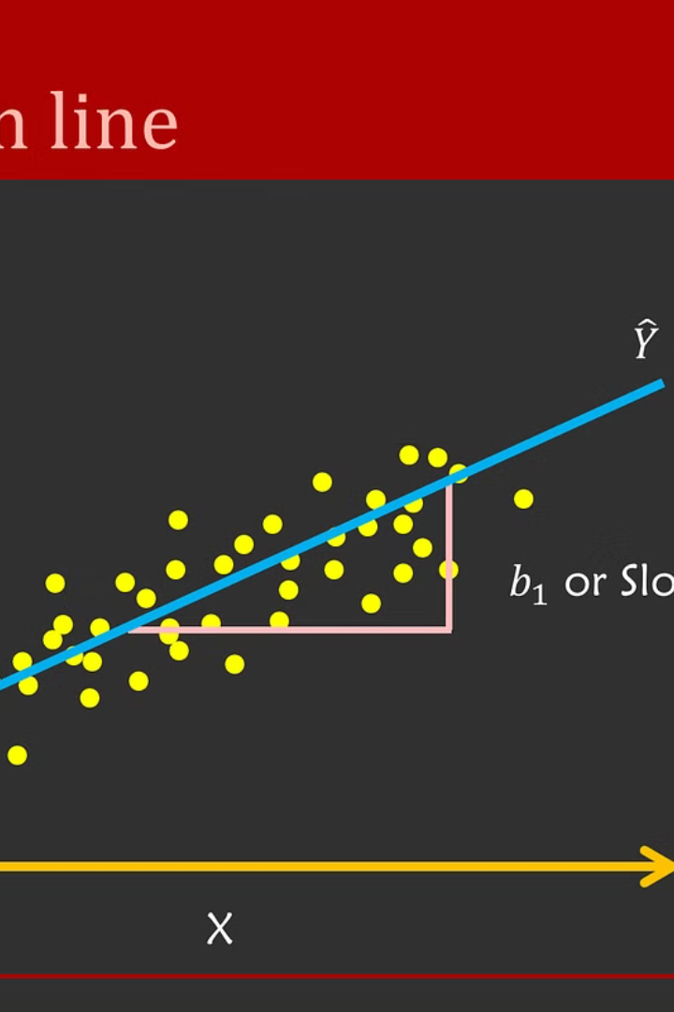

Introduction to Linear Regression
Linear regression is a statistical method for modeling the relationship between a dependent variable and one or more independent variables. It is a powerful tool for making predictions and understanding the influence of different factors.
by Prince Raj

Slide 2
Definition and Concept of Linear Regression
Definition
Concept
Linear regression is a linear approach to modeling the relationship between a scalar response and one or more explanatory variables.
It involves finding the best-fitting straight line through the data points to predict the response variable.

Slide 3
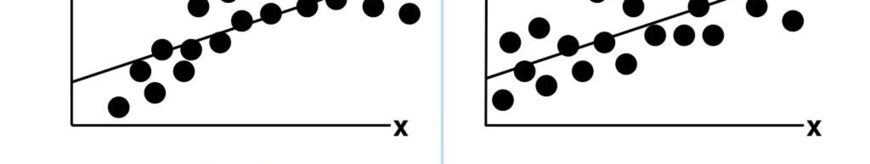
Assumptions of Linear Regression
1
Assumption 1
2
Assumption 2
3
Assumption 3
Linearity: The relationship between the independent and dependent variables is linear.
Independence: The residuals are independent of each other.
Homoscedasticity: The variance of the residuals is constant.

Slide 4




Steps to Perform Linear Regression Analysis
Step 1: Data Collection
Step 2: Model Building
Step 3: Model Evaluation
Obtain and clean the relevant data for analysis.
Select appropriate variables and build the regression model.
Assess the model's fit and predictive accuracy.

Slide 5
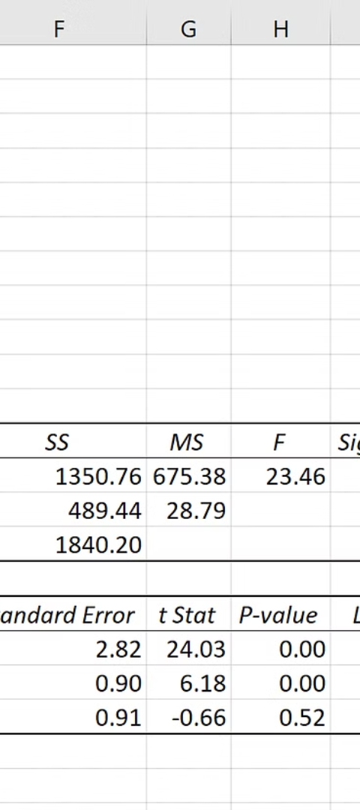
Interpretation of Regression Coefficients
Beta Coefficient
P-Value
Represents the change in the dependent variable for a one-unit change in the independent variable.
Indicates the probability of observing the data given that the null hypothesis is true.

Slide 6
Evaluation of Model Fit
R-Squared
MSE
Variance Explained
Mean Squared Error
Represents the proportion of the variance in the dependent variable that is predictable from the independent variables.
Measures the average of the squares of the errors between the actual and predicted values.

Slide 7

Limitations and Challenges of Linear Regression
Overfitting
Multicollinearity
When the model is too complex and captures noise as well as signal.
High correlation among independent variables, leading to unstable coefficients.

Slide 8
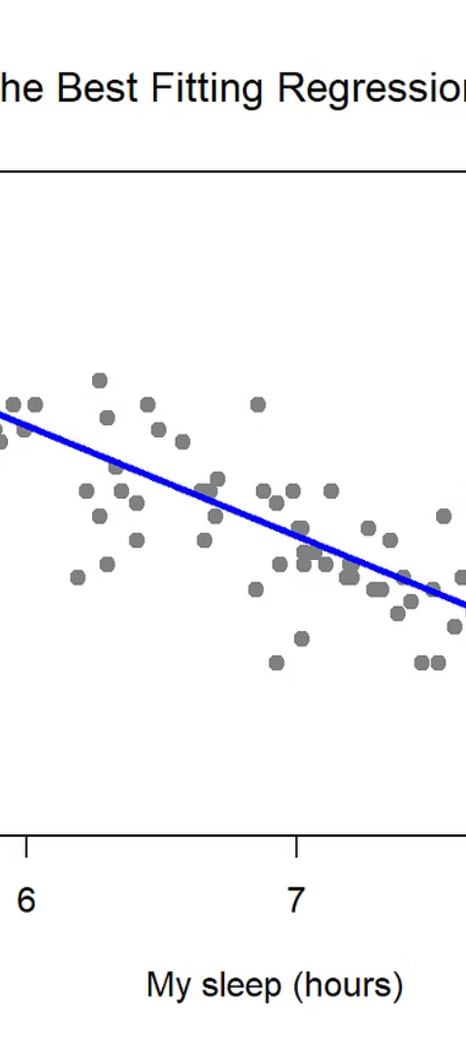
Conclusion and Key Takeaways
1
Insightful Predictions
Linear regression enables the generation of valuable predictions based on historical data.
2
Data-Driven Decision Making
It aids in making well-informed decisions supported by data analysis and statistical inference.
3
Continuous Improvement
Continuous evaluation and refinement of the model contribute to ongoing improvement and accuracy.

